Slide 1
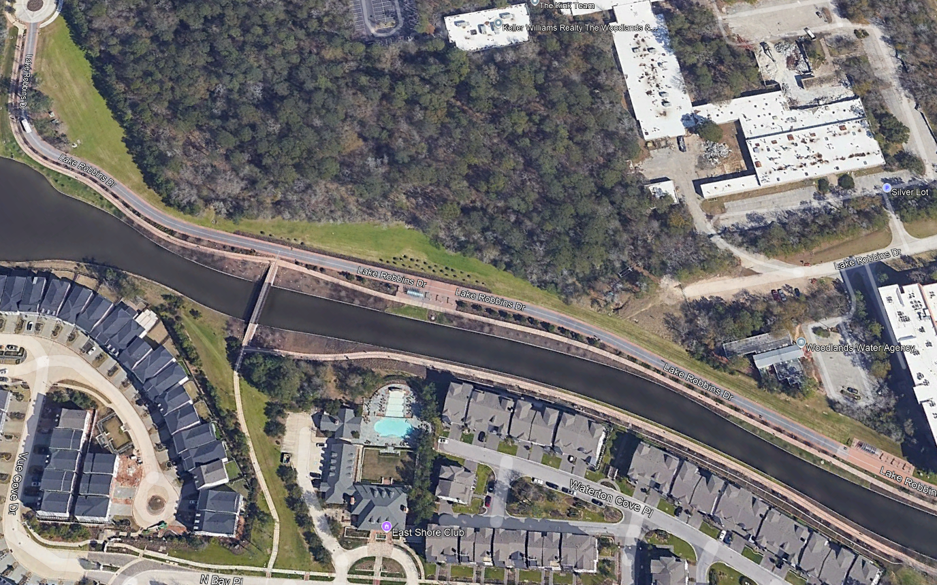
LOWER WATERWAY – PHASE 2
33 pole lights
4 Trolley lights
1 Trolley Stops
2 Bollards
2 Benches
1 Trashcans

